Slide 1


Data-Driven Storytelling Presentation: Sales Growth Strategy: Leveraging Online Retailer Accounts for Success

Slide 2
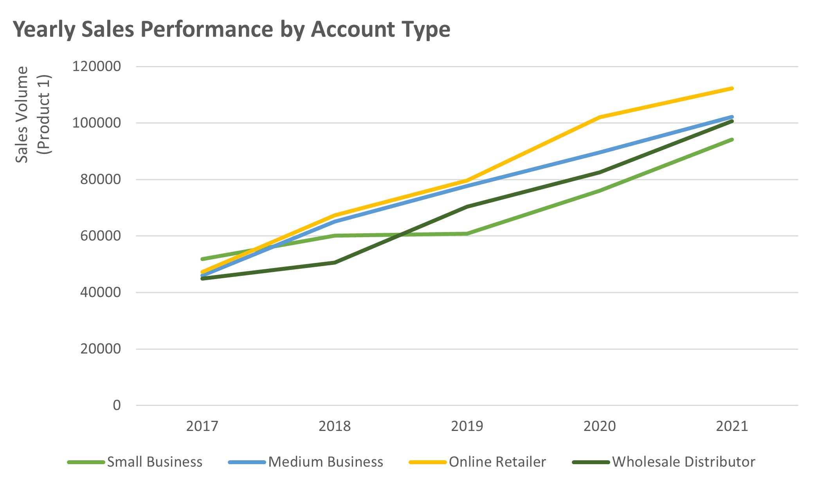
Visual Line graph showing sales volume growth from 2017 to 2021.
Key Point Online retailer accounts show consistent growth alongside other account types but with more potential for scalability.
Insight Online retailers have an upward sales trend, signaling an opportunity for strategic focus.

Slide 3
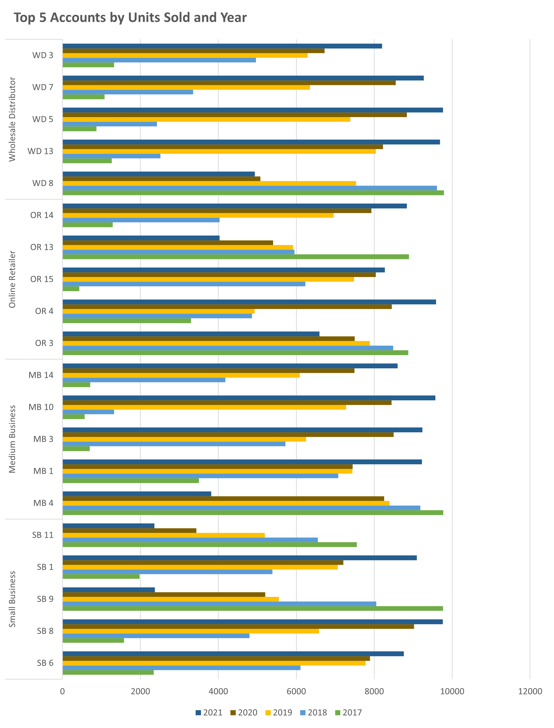
Key point, observation or data here…
Key Point: Accounts like OR 14 and OR 13 rank among the top performers, consistently driving substantial units sold each year.
Visual: Horizontal bar graph showing performance by account type and year.
Insight:
Online retailers dominate unit sales and present the best opportunity for scaling.

Slide 4
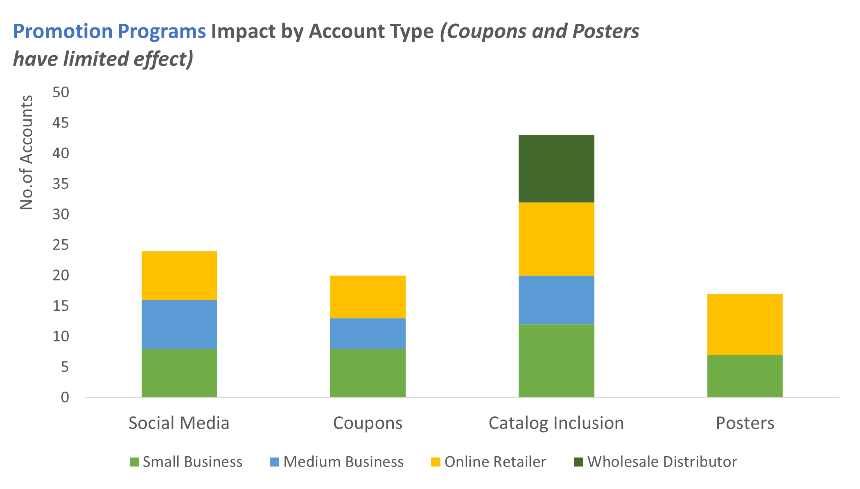
Key point, observation or data here…
Key Point: Online retailers benefit the most from catalog inclusion and social media promotions.
Visual: Stacked bar chart showing the number of accounts impacted by each promotion method.
Insight: Focus promotional efforts on strategies proven effective with online retailers to drive greater engagement and sales.

Slide 5
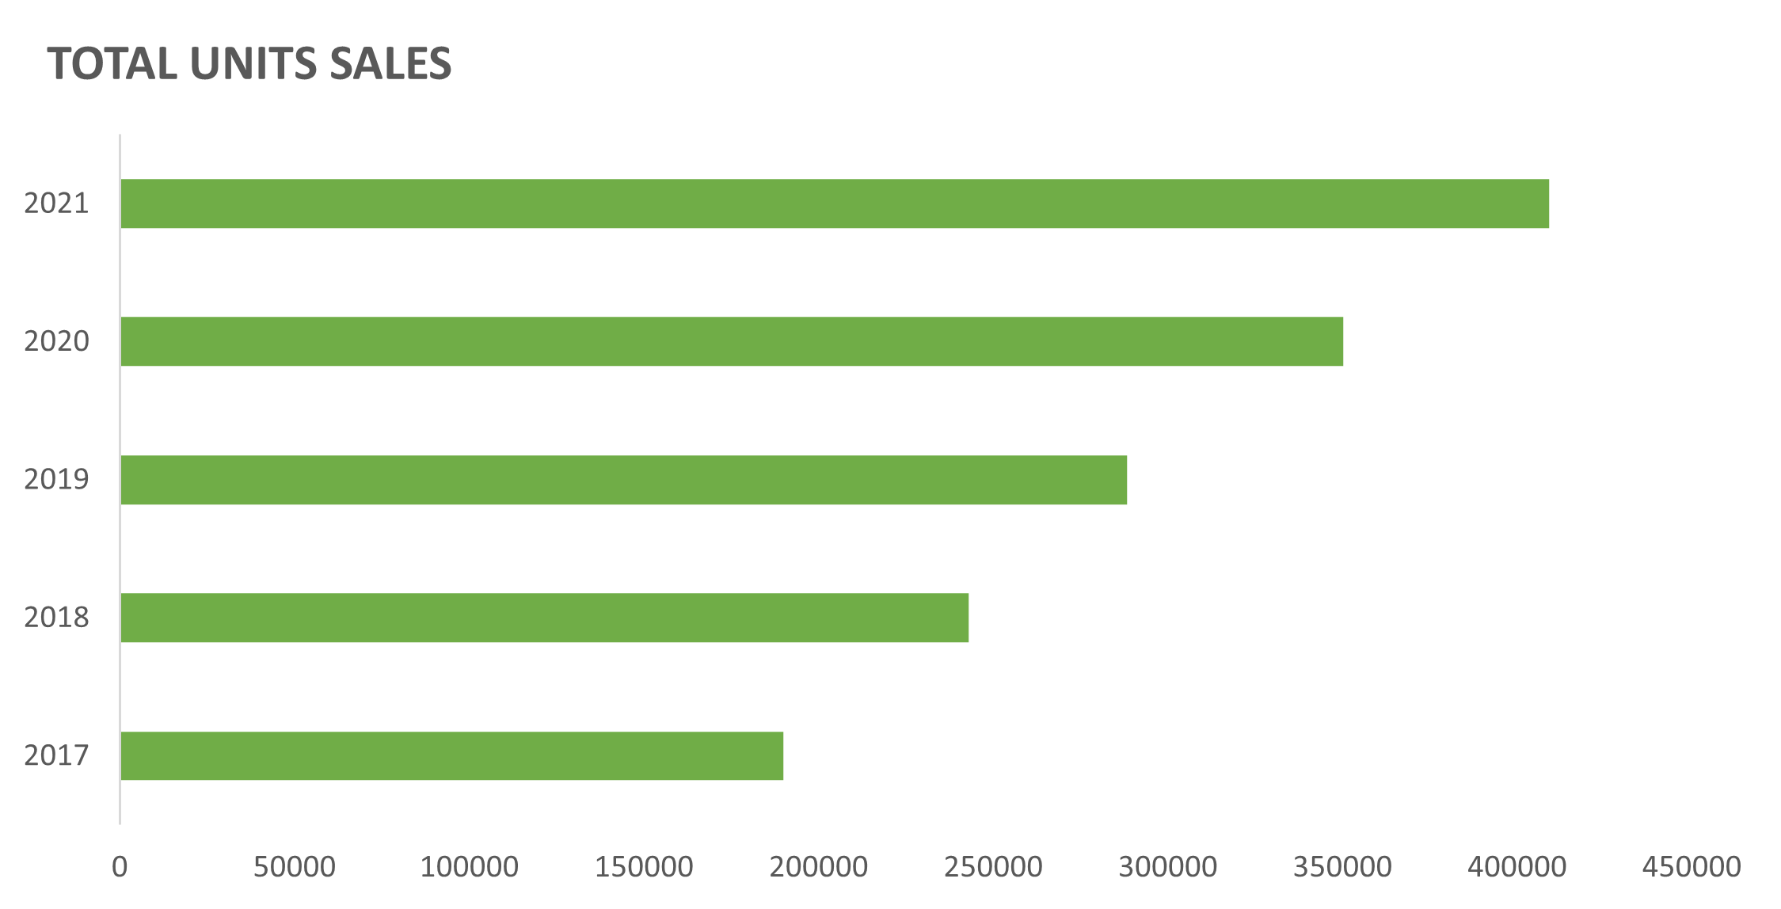
Key point, observation or data here…
Key Point: A significant sales boost occurred in 2021, with online retailer contributions playing a key role.
Visual: Horizontal bar graph showing total yearly unit sales.
Insight: Capitalizing on the online retailer segment will likely push future sales even higher.

Slide 6

Summary
Recommendation: Shift resources toward growing online retailer accounts by prioritizing effective promotions and targeted marketing. This strategy will maximize sales potential in the fastest-growing segment.
Call to Action: Adjust sales strategies to emphasize online retailer expansion, leveraging data-driven insights to optimize efforts.

